Slide 1


Deep Learning for Natural Language Processing DLNLP 1: Introduction
Mihai Surdeanu and Marco A. Valenzuela-Escárcega

Slide 2
Resources
Text and code available here: https://clulab.org/gentlenlp/

Slide 3
Computer Science
Artificial Intelligence
Machine
Learning
Deep
Learning
Natural
Language
Processing

Slide 4
Why machine learning?

Slide 5
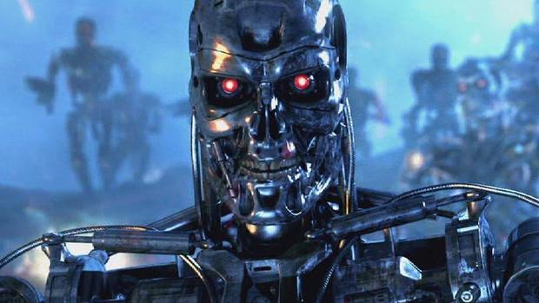
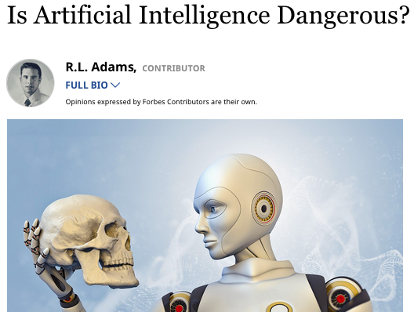
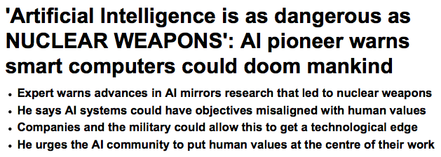

Slide 6
Those things probably won’t happen.
But you are already using many applications of machine learning today.

Slide 7


You wake up listening to your music
Examples from The Master Algorithm, by Pedro Domingos

Slide 8
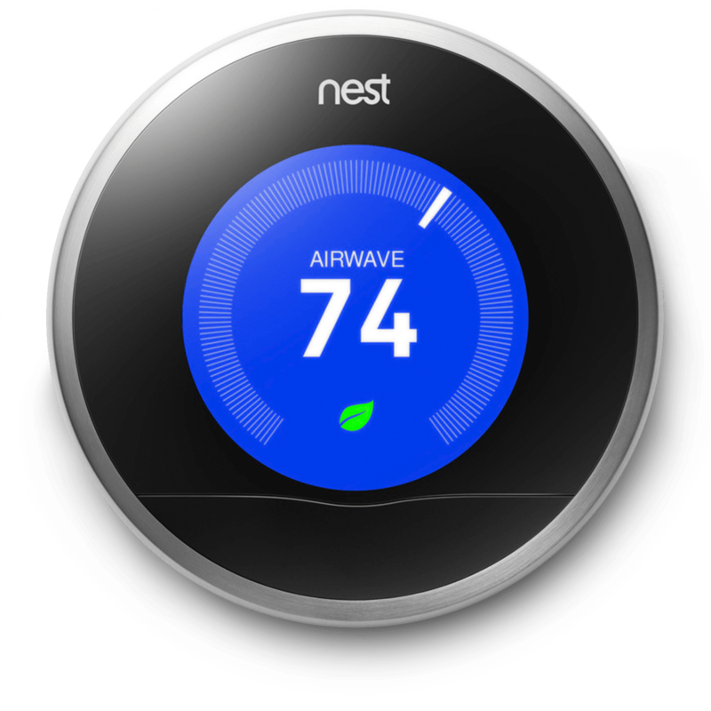
The temperature is adjusted for you
Examples from The Master Algorithm, by Pedro Domingos

Slide 9
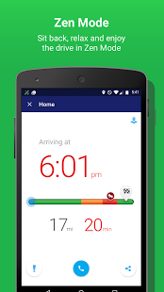
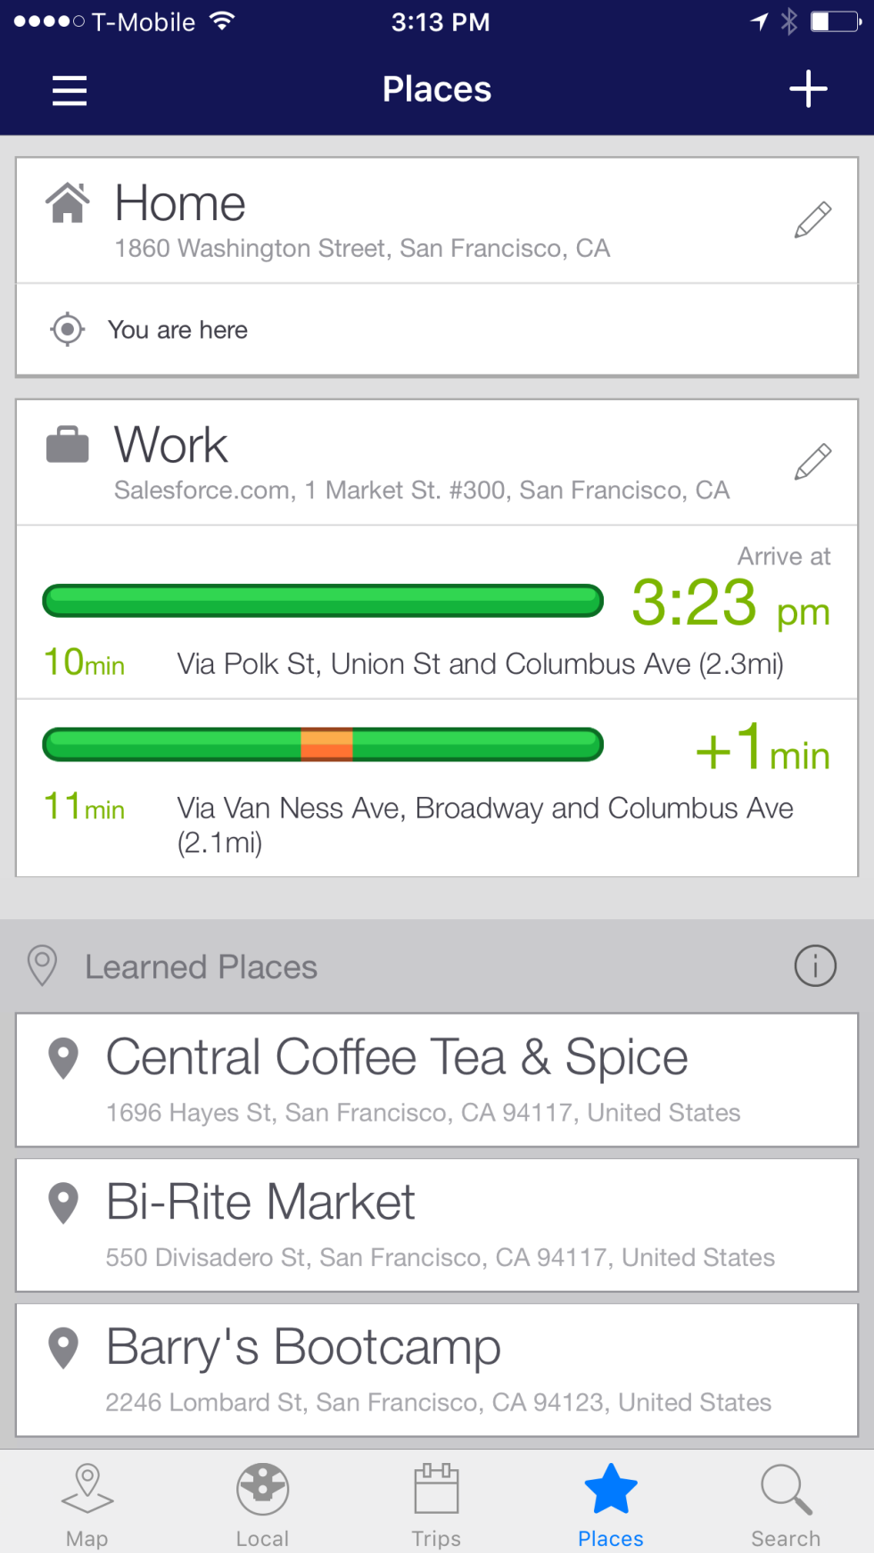

An algorithm predicts traffic when you drive to work
Examples from The Master Algorithm, by Pedro Domingos

Slide 10
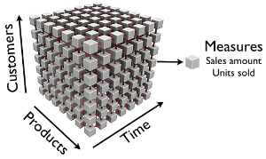

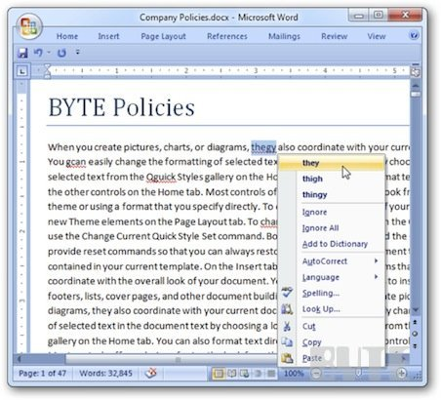

At work…
Examples from The Master Algorithm, by Pedro Domingos

Slide 11
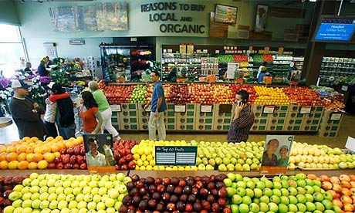

After work, at the supermarket…
Examples from The Master Algorithm, by Pedro Domingos

Slide 12


Back at home, you walk your dog to get your mail
Examples from The Master Algorithm, by Pedro Domingos
Notes:
ML monitors video feeds to keep you safe
Letters routed by an algorithm that reads hand-written addresses

Slide 13
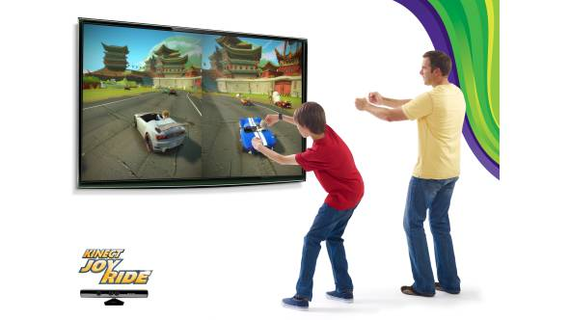
After dinner you play with your kids
Examples from The Master Algorithm, by Pedro Domingos
Notes:
Xbox Kinnect tracks movement

Slide 14

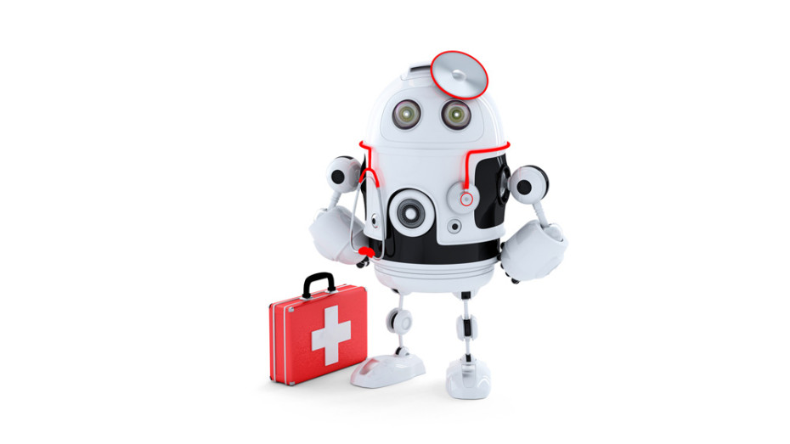
You take a pill before calling it a day
Examples from The Master Algorithm, by Pedro Domingos
Notes:
take a pill at night: diagnosed with help of ML, drug designed/tested with ML <=== Reach

Slide 16
Why natural language processing?

Slide 17
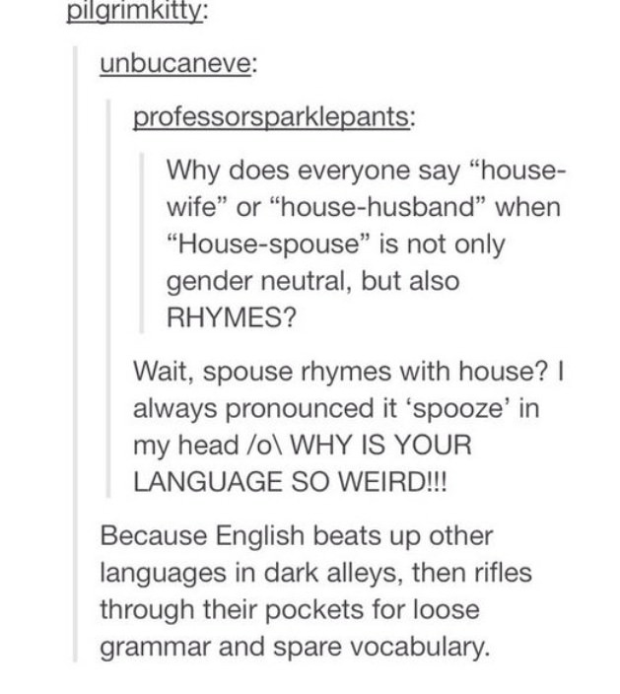
Language is beautiful and hard…

Slide 18
“Beating up” other languages
Why do we eat “pork” and “beef” but we raise “pigs” and “cows”?
What is the percentage of cognates with French in English?

Slide 19
Syntactic analysis
“Our company is training workers.”
Correct: “is training” as a verb group

Slide 20
Syntactic analysis
“Our company is training workers.”
Incorrect: “training” modifies “workers, as in: “Those are training wheels.”
Why does syntactic analysis still matter?

Slide 21
Ambiguity and selectional preferences
I swallowed a bug while running.
What selectional preferences would you add for the verb “swallow”?
I swallowed his story, hook, line, and sinker.
The supernova swallowed the planet.

Slide 22
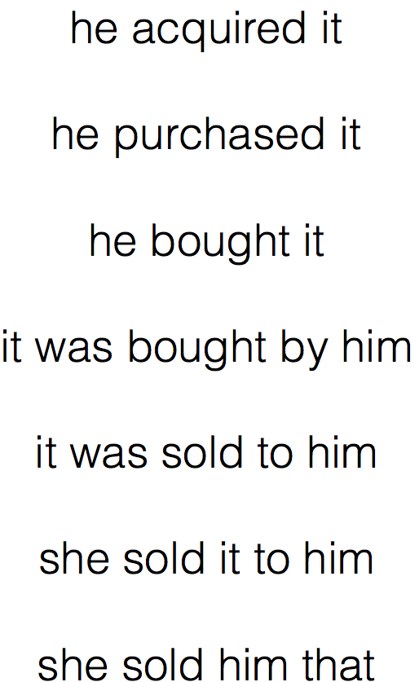
Variability
Slide by Yoav Goldberg

Slide 23

Discourse/Ellipsis/Multi-modality/Humor/Sarcasm/Etc.

Slide 24
Language is infinite
A new expression I discovered this summer abroad:
“Please so much”

Slide 25
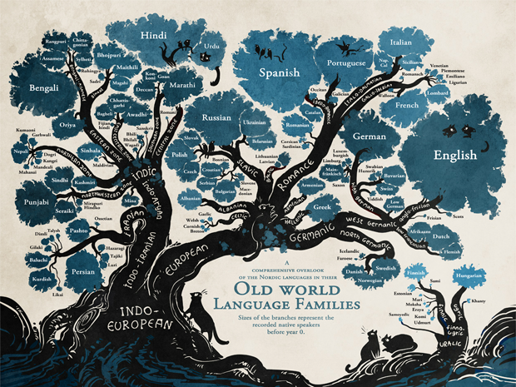
There are about 7K languages in the world

Slide 26
language understanding enables important applications

Slide 27
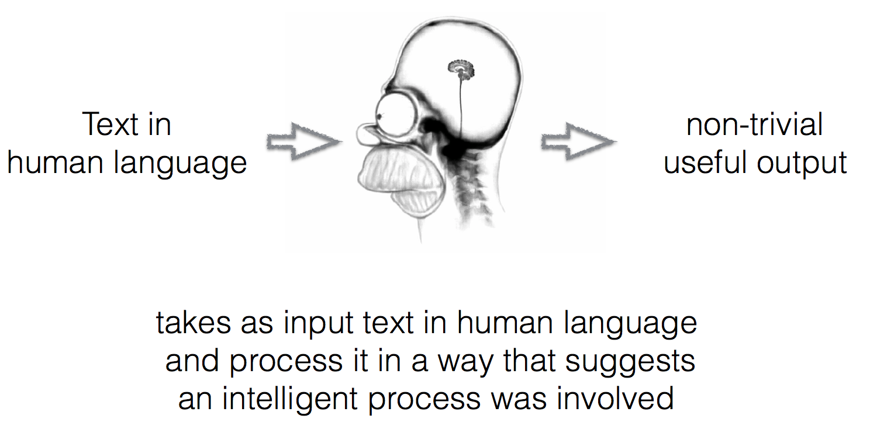
Natural Language Processing (NLP) in a nutshell
Slide by Yoav Goldberg

Slide 28
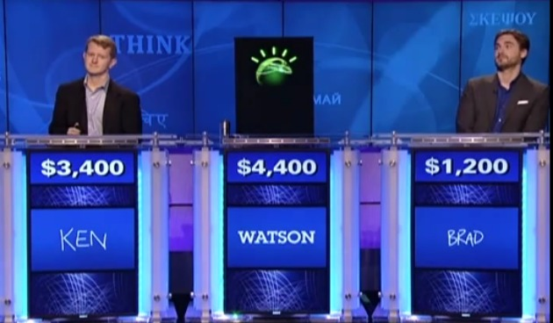
NLP Applications Question Answering

Slide 29
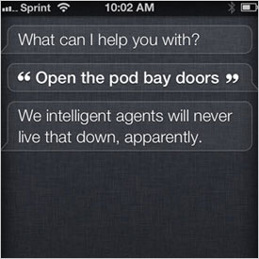
NLP Applications Question Answering

Slide 30
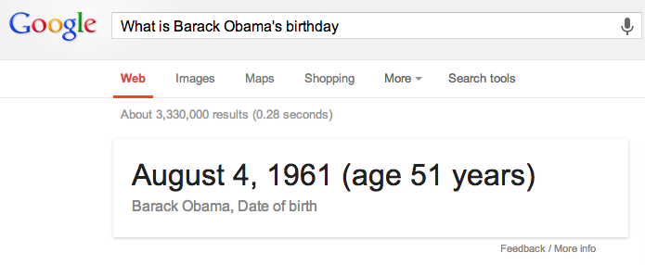
NLP Applications Question Answering

Slide 31
NLP Applications Question Answering
When athletes begin to exercise, their heart rates and respiration rates increase. At what level of organization does the human body coordinate these functions?
A: at the tissue level
B: at the organ level
C: at the system level
D: at the cellular level
Unsolved problem!
Needs logical inference
Very little training data

Slide 32
Machine reading/information extraction
Human domain experts are around here

Slide 33
Machine reading/information extraction

Slide 34
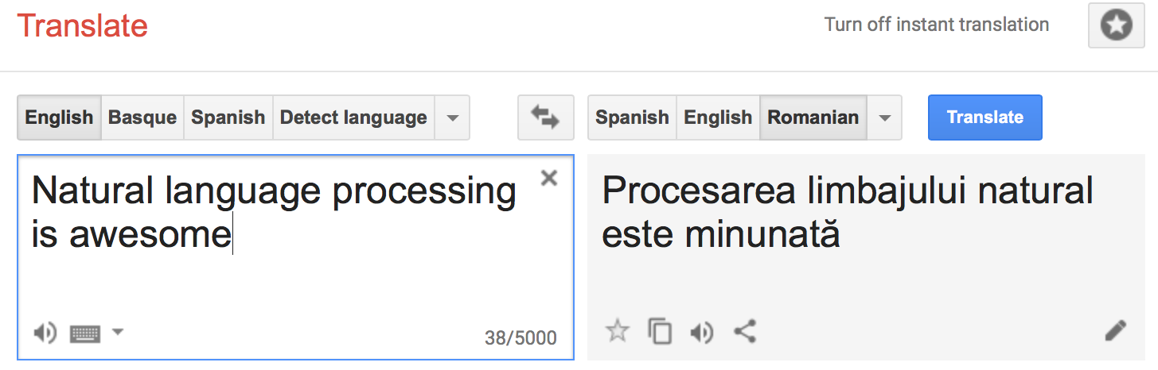
Machine translation

Slide 35
And many others…
Exercise: can you suggest a few other NLP applications?

Slide 36
Most NLP applications are built using deep learning
Deep learning = subset of machine learning methods that use artificial neural networks (ANN)
Simplest ANN has 1 neuron = perceptron (we will discuss this soon)

Slide 37
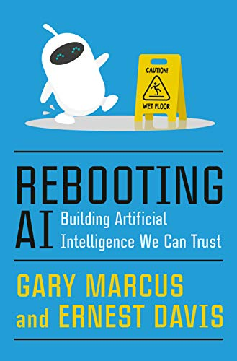
Deep learning is far from perfect
Deep learning is opaque, brittle, and has no commonsense

Slide 38
Why another deep learning course?

Slide 39
